Slide 1





WELCOME
to the
Apollo Guidance Computer
Notes:
1

Slide 2
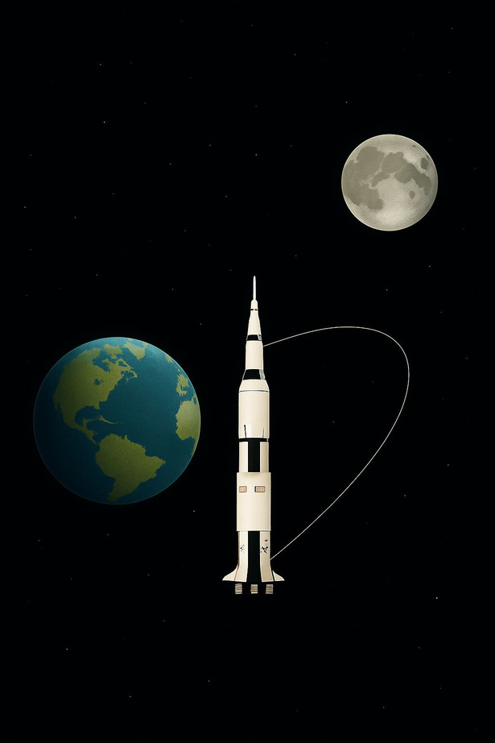
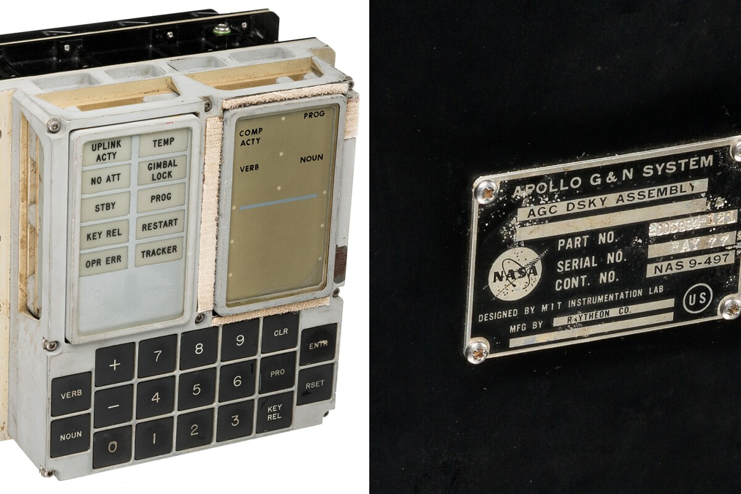
Start with the big idea
The Apollo astronauts didn’t have touchscreen or mice.
Instead, they talked to the computer using special language made of VERBs and NOUNs.
Just like in English, a verb tells you what action to do, and a noun tells you what to do it to.
Notes:
2

Slide 3
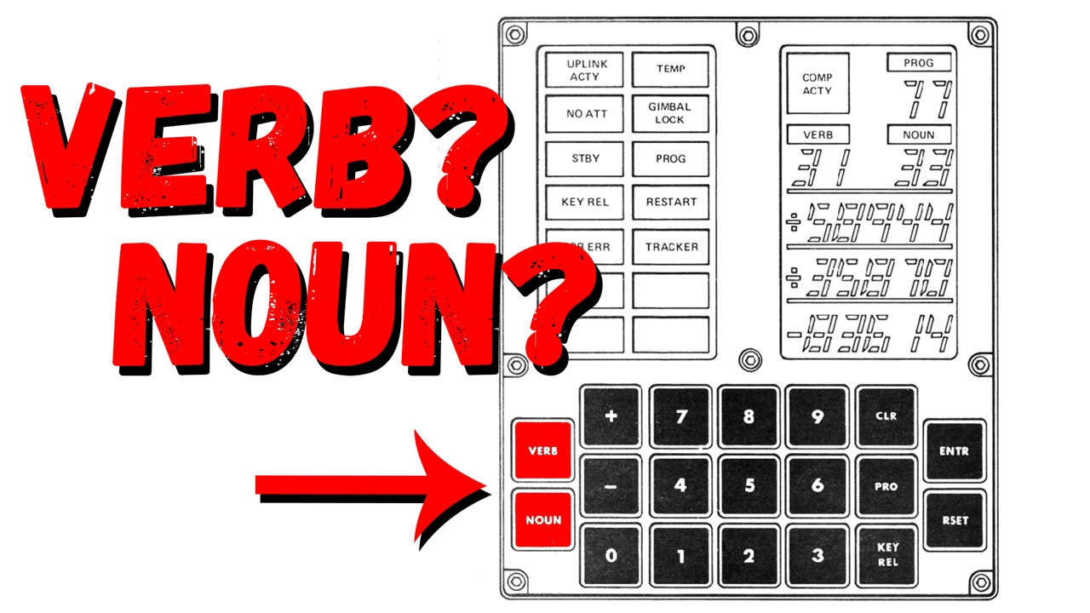
Explain the format
Every command looked like this: V## N##
V = VERB (action)
N = NOUN (data or object)

Slide 4
VERB 16 NOUN 36
V16N36 was an Apollo Guidance Computer command that told the DSKY to display and keep updating the Ground Elapsed Time—the official mission clock—so astronauts always had a clear, reliable view of how long the mission had been running.
DISPLAY 01
Time in Hours
DISPLAY 02
Time in Minutes
Time in Seconds and hundredths of a second
DISPLAY 03

Slide 5
VERB 25 NOUN 36
V25N36 was the AGC command to manually set the Ground Elapsed Time by entering hours, minutes, and seconds, allowing astronauts to sync the onboard clock with Mission Control for accurate, time-critical maneuvers.
DISPLAY 01
Time in Hours
DISPLAY 02
Time in Minutes
Time in Seconds and hundredths of a second
DISPLAY 03

Slide 6
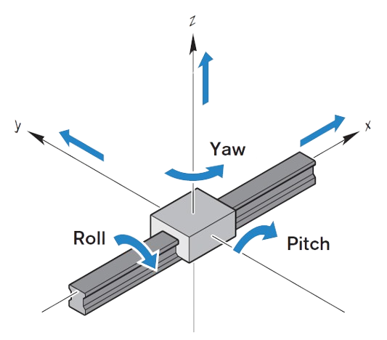
VERB 06 NOUN 22
DISPLAY 01
Roll Angle
V06N22 on the Apollo Guidance Computer displayed the spacecraft’s new gimbal angles, the rotation values calculated by the AGC for orienting the Inertial Measurement Unit. Using Verb 06, the data appeared once in decimal form on the DSKY, giving astronauts a snapshot of the precise attitude needed for upcoming maneuvers.
Pitch Angle
DISPLAY 02
DISPLAY 03
Yaw Angle

Slide 7
